Slide 1


Slide 2
Meet Our Team!!
Title
API Security Shield (Infosec)
Team Name
shrinivas.jivandhar2021
Team Members
Ayush Bhandari, Shrinivas Chigare
College
Vellore Institute of Technology
Date
18-08-202

Slide 3


Slide 4





Executive Summary
Problem
Proposed Solution
Objectives
Approach
Expected Impact
APIs are critical components of modern applications and are prone to various security threats that can be exploited if not properly managed.
API Inventory Management
API Scanning Integration into the SDLC
OWASP Top 10 attack coverage
API security issue management
Enhance API security through continuous monitoring and real-time threat detection.
Provide a centralized platform for managing API security.
Ensure scalability and integration into the existing SDLC.
Implemented automated security scans, real-time monitoring.
API inventory management and a user-friendly dashboard.
Improved security posture for APIs, better risk management,
and increased protection against common security threats.

Slide 5
Technical Approach
Methodology
Integrated OWASP Top 10 security tests.
Tools and Technologies
FastAPI: For building the backend API.
Algorithm/Logic
Security Checks: Implemented various security checks with customizable payloads.
Broken Auth, BOLA, Excessive Data Exposure, Rate Limiting, Mass Assignment, Security Misconfiguration, Injection, Asset Management, Logging Monitoring
Built a scalable and user-friendly dashboard.
SQLAlchemy: For ORM and database management.
React & Ant Design: For UI Development
OWASP- ZAP & ASTRA by Flipkart: Modified and used source code for advanced API security scanning.
Database Handling: Used SQLAlchemy for handling database operations and storing scan results.

Slide 6
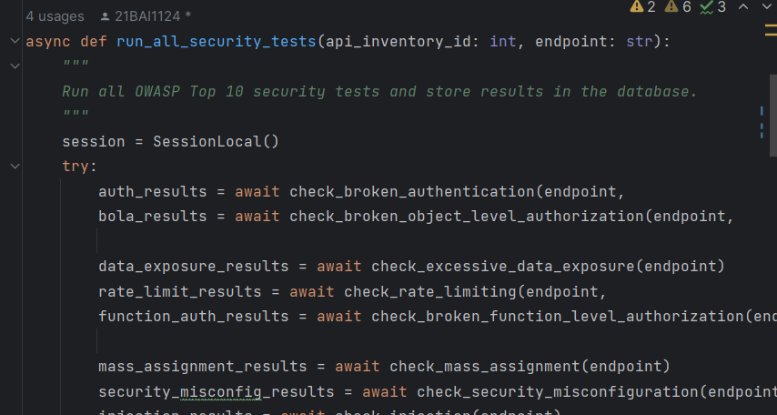
Technical Approach
Code Snippets
Planning to deploy backend on a cloud server.
Deployment & Testing
Set up FastAPI with SQLAlchemy.
Setup and Configuration
Integrated OWASP-ZAP & ASTRA for security scanning.
Configured frontend with ReactJS and Ant Design.
Frontend to be hosted on a web server.
Test cases includes different attack vectors and scenarios.

Slide 7

Results
Critical Vulnerabilities
Medium-Severity Vulnerabilities
Low-Severity Vulnerabilities
Detected several high-severity vulnerabilities including SQL Injection and Remote Code Execution (RCE).
Identified vulnerabilities such as Cross-Site Scripting (XSS) and Cross-Site Request Forgery (CSRF).
Found issues like missing security headers and weak password policies.
These were less critical but still posed significant risks.
These vulnerabilities were identified in multiple endpoints and required immediate remediation.
These were less impactful but important for overall security hygiene.

Slide 8


Challenges and Limitations
Limited support for some advanced attack vectors.
Integration with existing systems.
Limitations
Challenges
Handling false positives in security scans.
Scalability issues with very high API traffic.

Slide 9

Recommendations and Future Work
Continuous enhancement of security tests based on new threats.
Explore integration with more advanced security tools like Burp Site.
Regular updates to the scanning toolset.
Improve scalability to handle higher traffic loads.
Explore the use of machine learning algorithms to detect unusual patterns in API traffic, identifying potential security breaches in real-time.
Automate the patching process to quickly address vulnerabilities identified during scans.

Slide 10
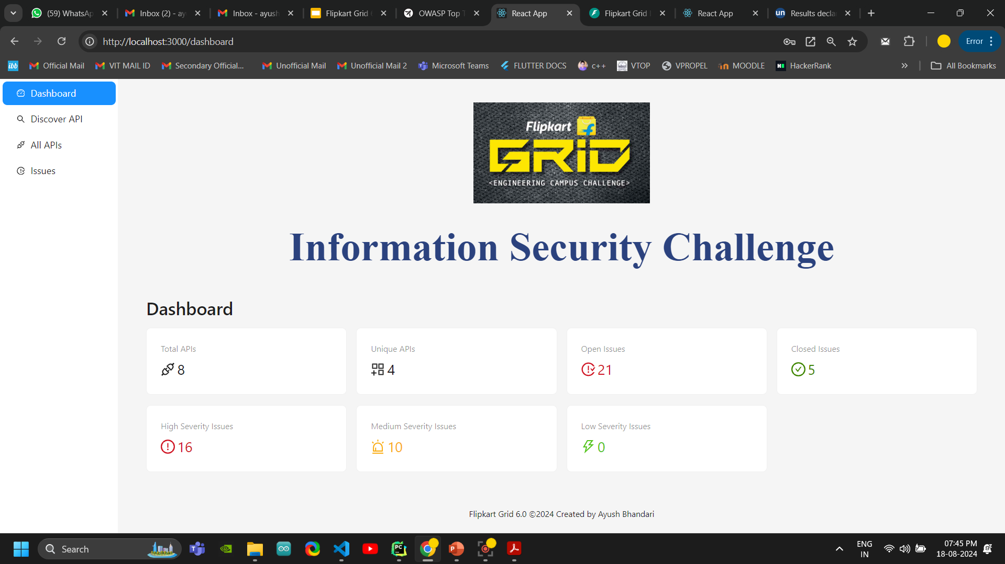
Appendices

Slide 11
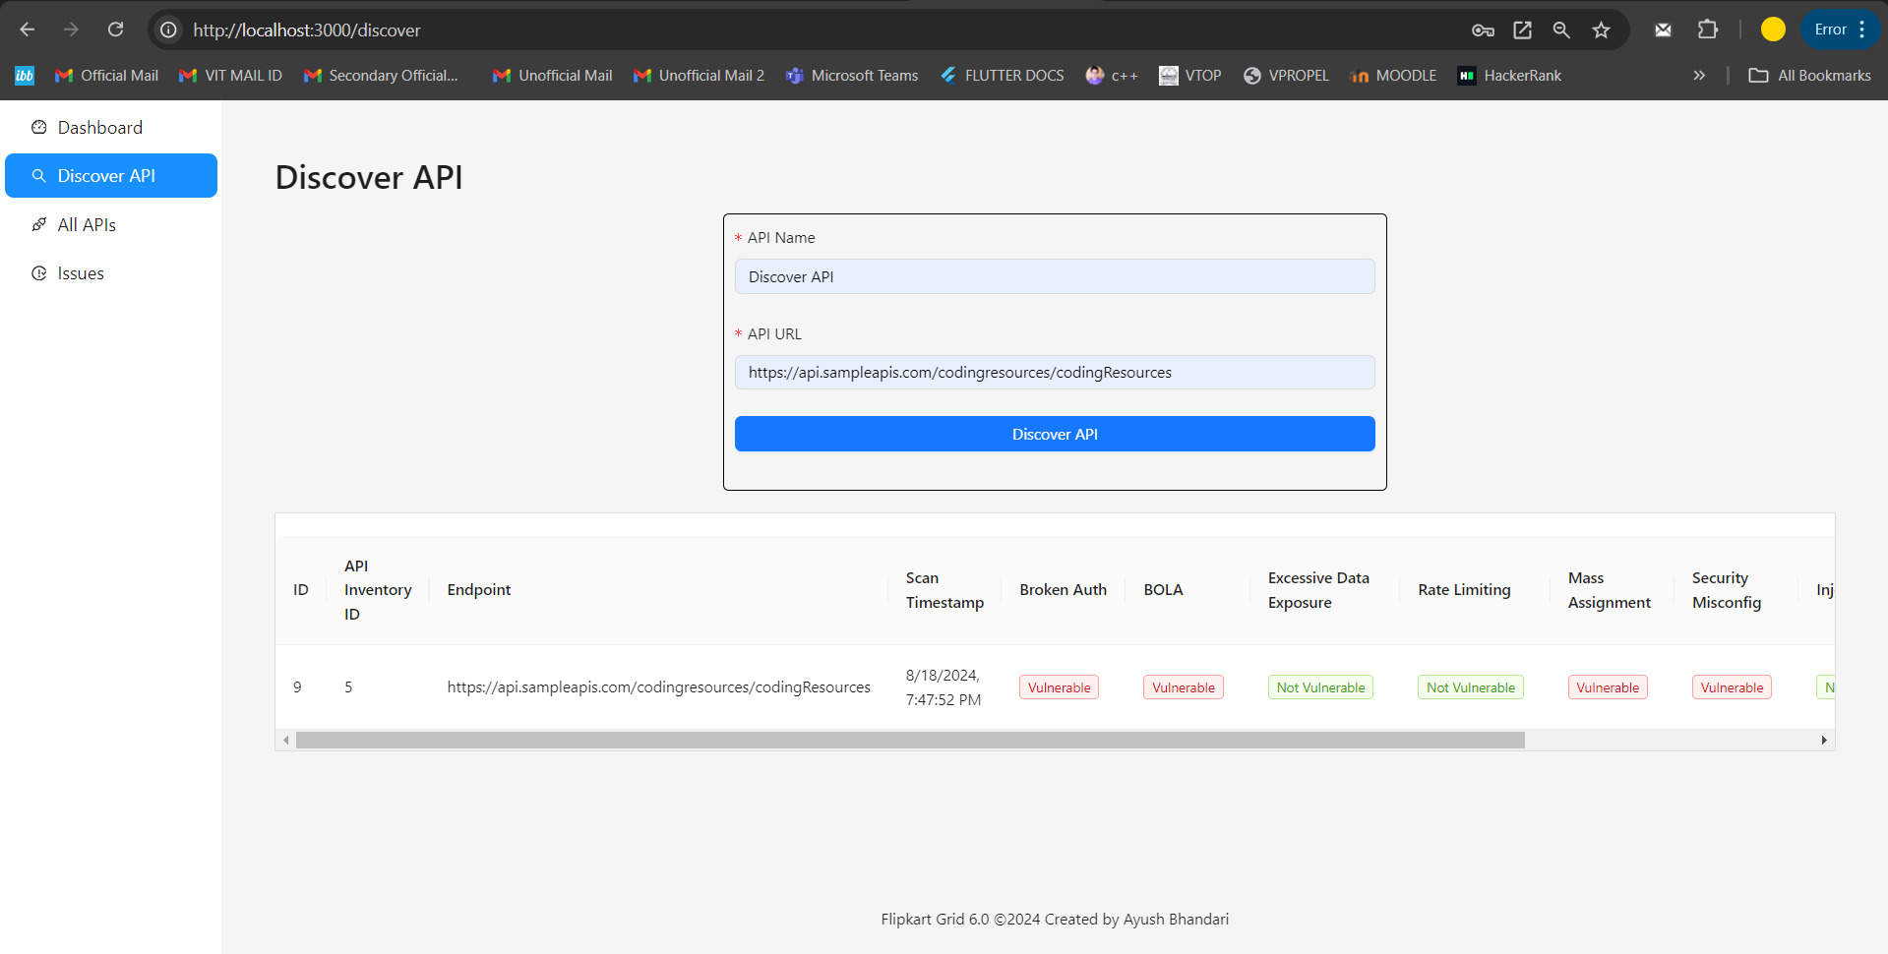

Slide 12
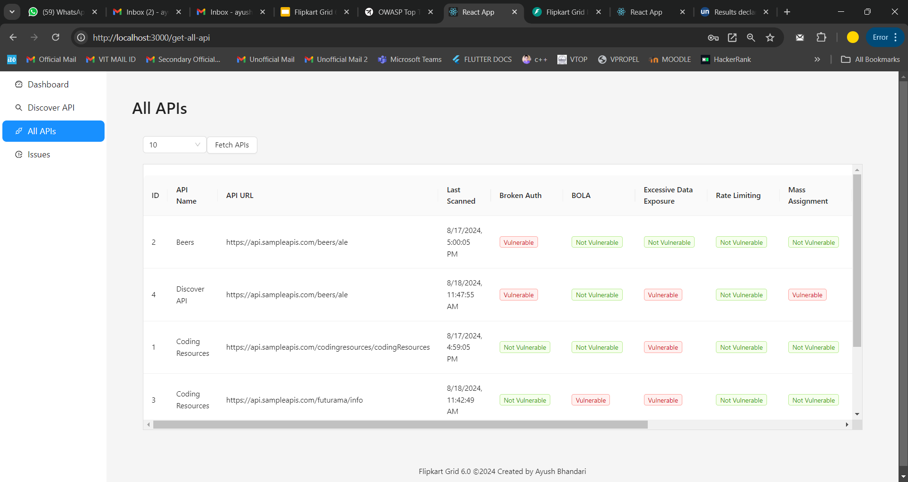

Slide 13
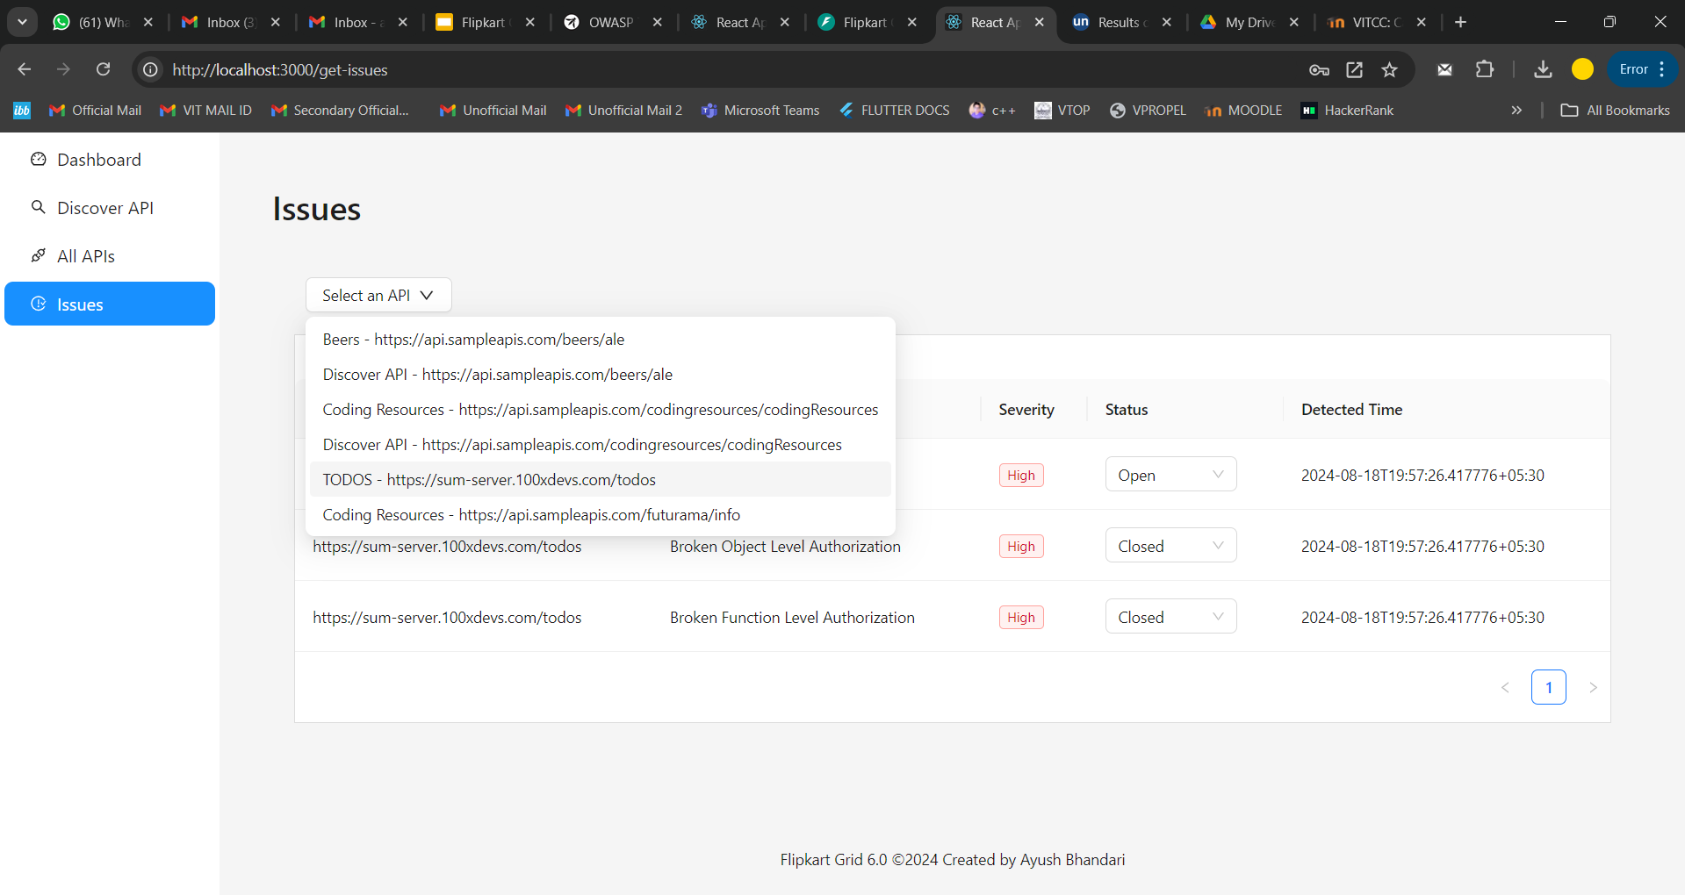

Slide 14
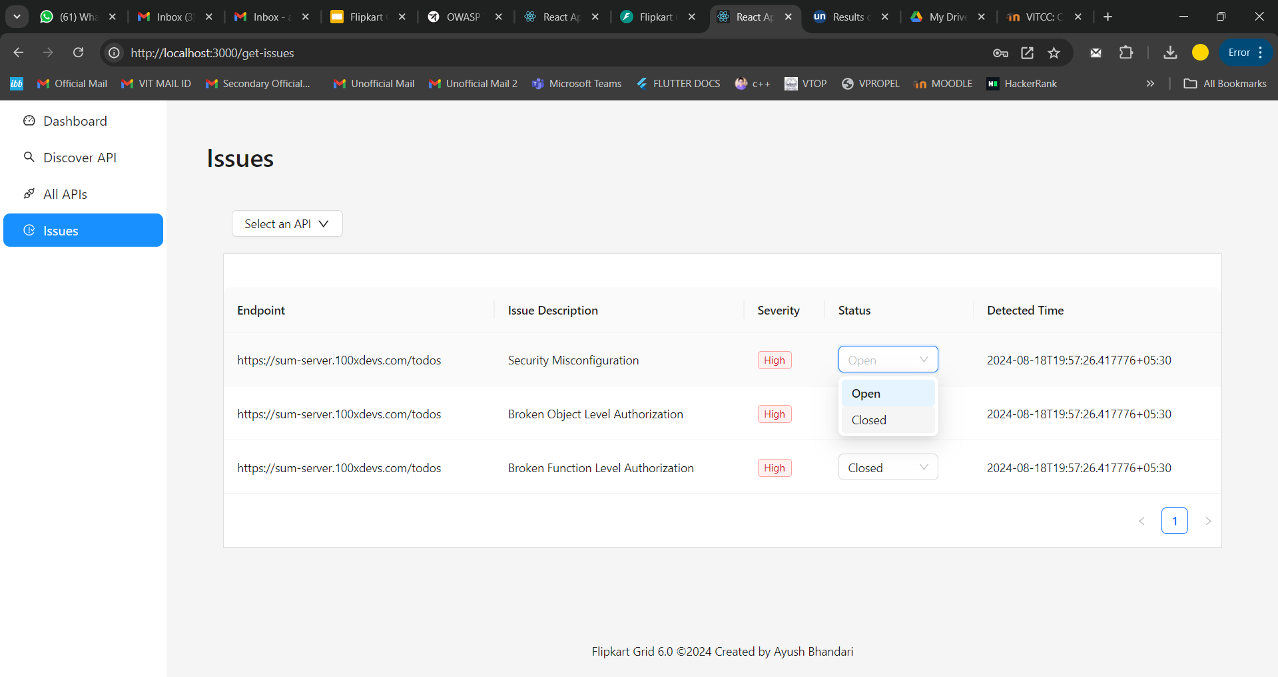

Slide 15
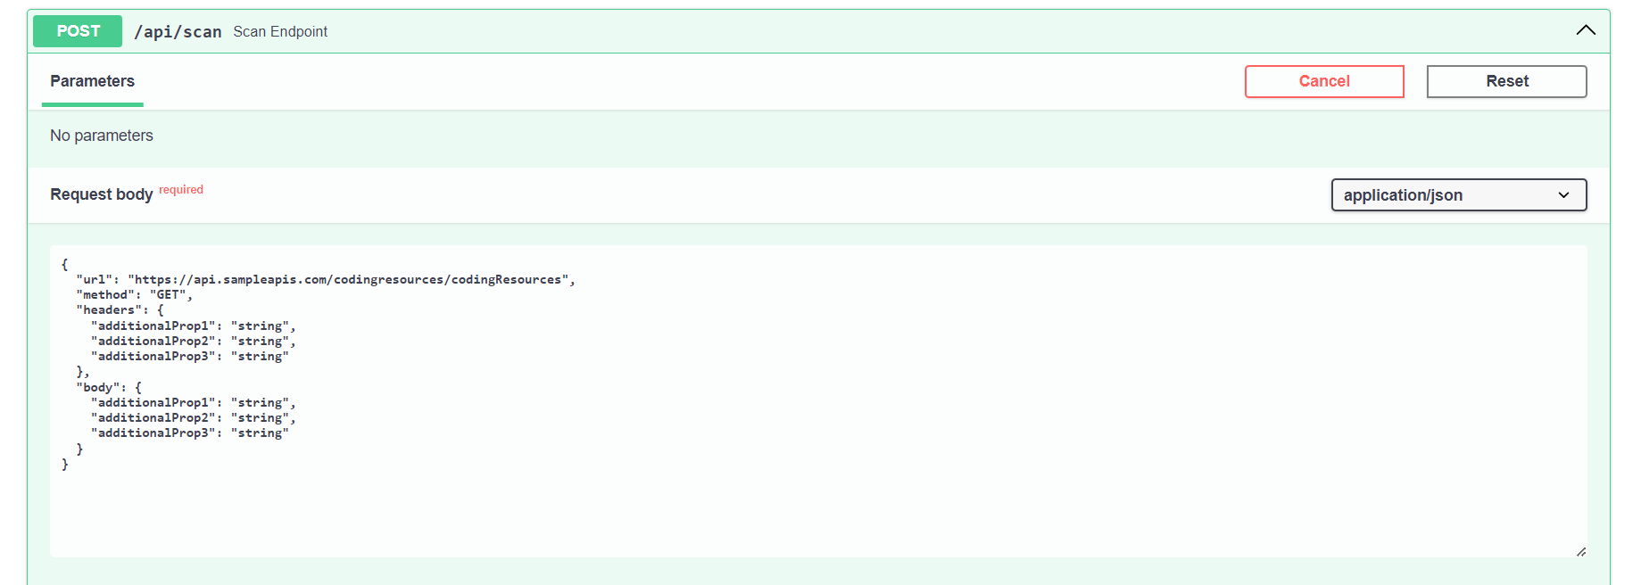

Slide 16
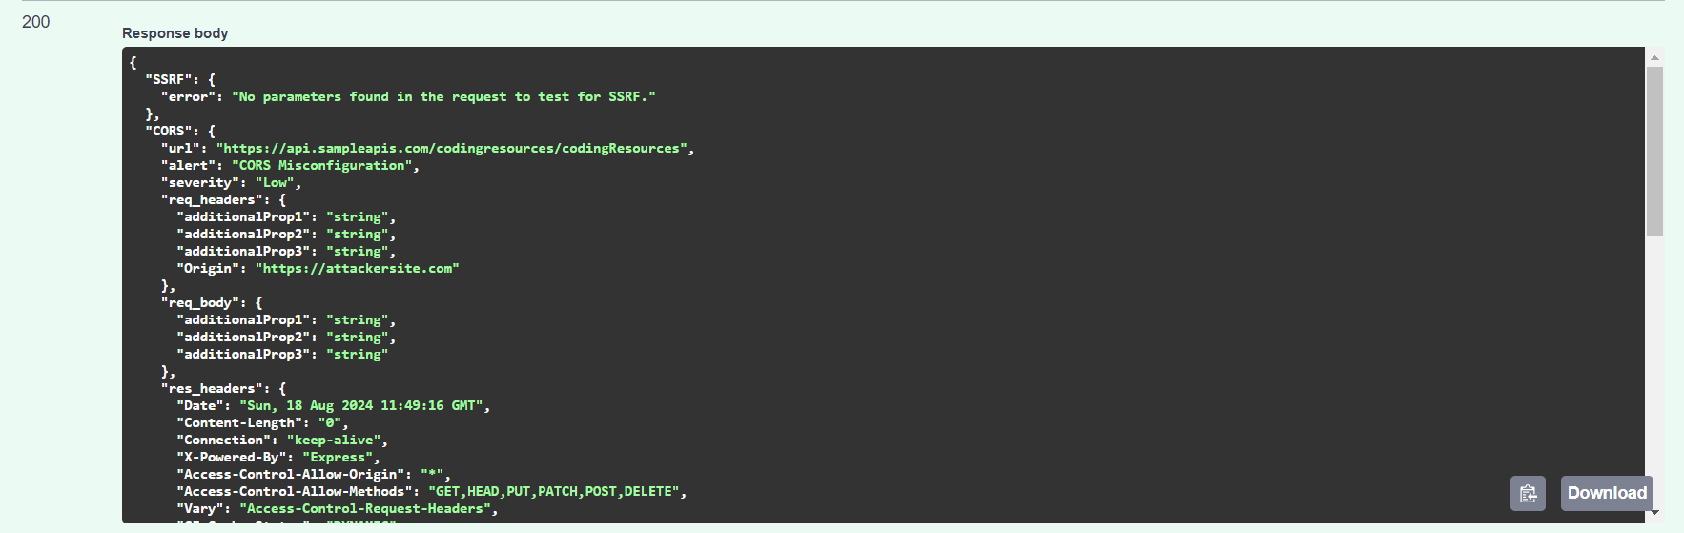
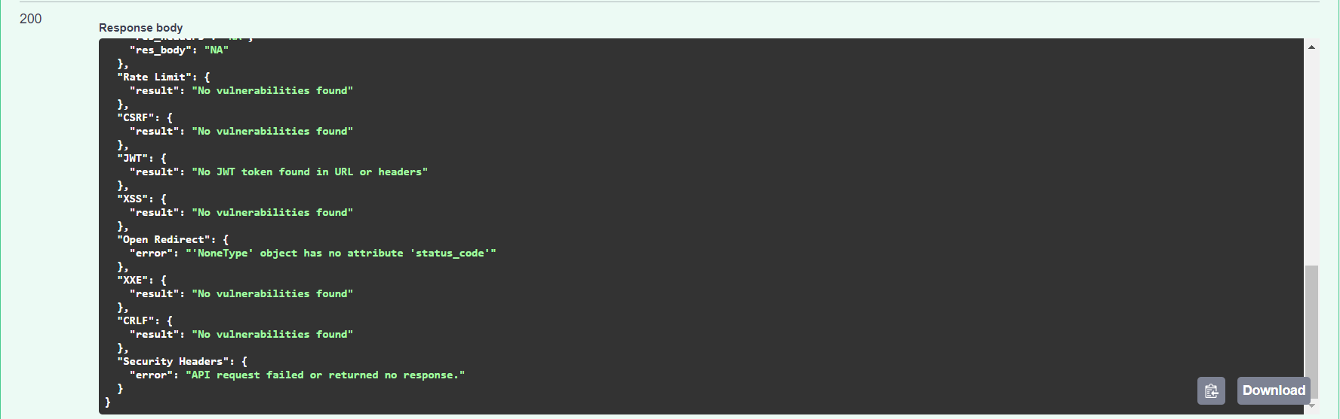

Slide 17
Thank-you
GitHub Repository Link (Private)

